Slide 1



European Space Agency Education

Slide 2
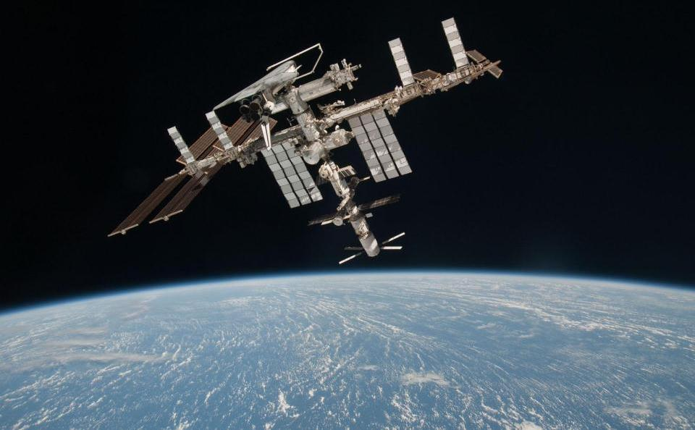
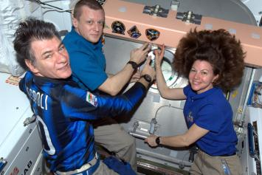
Γενικοί στόχοι
Αύξηση της εκτίμησης και της κατανόησης για τα οφέλη, τις προκλήσεις και τη σημασία του διαστήματος για την Ευρώπη
Εκπαιδευτικός στόχος του ESA ISS: Αύξηση, μέσω της εκπαίδευσης, του ενδιαφέροντος και της ευαισθητοποίησης για τις «επανδρωμένες» πτήσεις στο διάστημα
Αύξηση του ενδιαφέροντος των νέων για τις STEM
Notes:
Use astronauts and the ISS to attract the younger generation to sciences and to provide an exciting platform and materials from which educators can enhance the teaching of STEM subjects.
Activities surrounding payload operations provide a memorable opportunity for children and young students to perform hands-on activities during which they will experiment, learn and remember basic scientific principles.

Slide 3
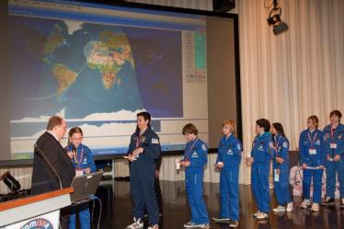
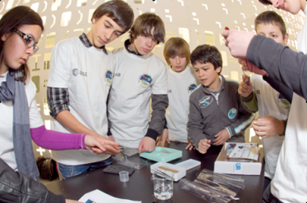
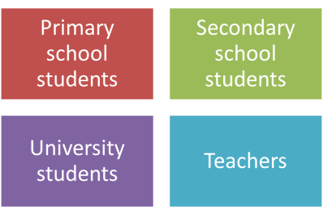
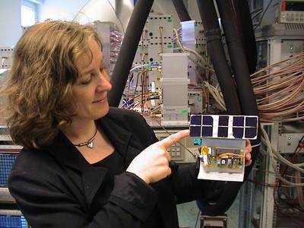
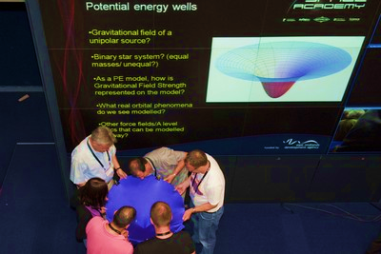
Άμεσες ομάδες/στόχοι

Slide 4
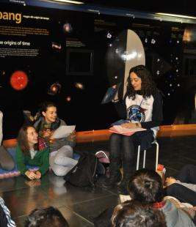
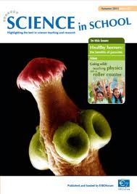
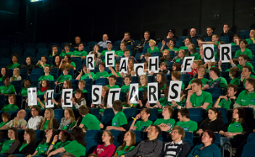
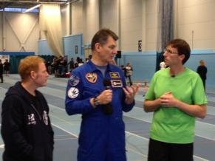
Έμμεσες ομάδες/στόχοι
Μη τυπικοί εκπαιδευτές (μουσεία, κέντρα επιστημών)
Υπουργεία παιδείας (μέσω συμβούλων ή διαμεσολαβητών)
Μέσα (επιστημονικά περιοδικά ,π.χ. Science in School)

Slide 5
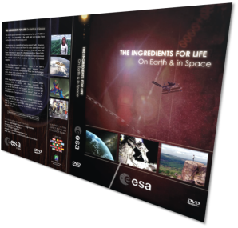
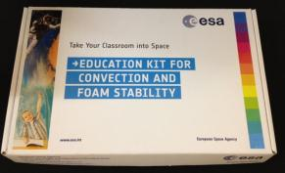
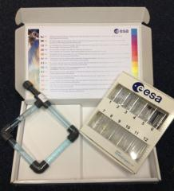
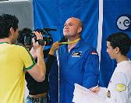
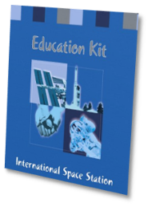
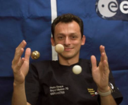
Παραγωγή εκπαιδευτικού υλικού (1)
ISS education kits
  Πακέτο ISS για την Π/θμια εκπ/ση
  Πακέτο ISS για τη Δ/θμια εκπ/ση
  > Μεταφρασμένα σε 12 γλώσσες
DVDs
Mission 1, 2, 3, 4
  Newton’s laws
  Body in Space
  Materials in Space
  Space Robotics
  Άλλα
  Ingredients for Life
  Nutrition on Earth and in Space
  Space Travel: An ATV perspective

Slide 6


Παραγωγή εκπαιδευτικού υλικού (2)
Online μαθήματα
Μαθητές Λυκείων
Space-in-bytes - movies 4-8 mins on ISS activities
Πρωτοβάθμια και Γυμνάσια (> 12)
  Convection
  Foam stability
  Life in Space
  A drop of water
  ATV
  Radiation
  Gravitation and weightlessness etc..
  Μεταφρασμένα σε 13 γλώσσες
Online clips and YouTube videos
    http://www.youtube.com/esa
Notes:
Upper Secondary : Space-in-bytes
European science goes into orbit
ATV: a very special delivery
Science fiction: science fact
Searching for the Missing Universe
Primary and secondary
Columbus
ATV
Life in Space
A drop of water
A foam’s life
Radiation
Gravitation and weightlessness
A space compass
Bugs in Space
Space (fluid) oddities
ATV lesson notes

Slide 7
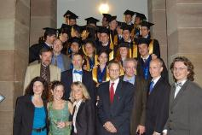
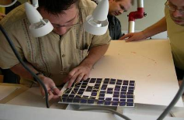
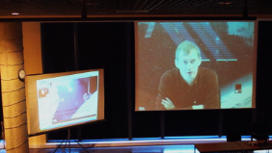
Εκπαίδευση πανεπιστημιακού επιπέδου
SpaceMaster - Erasmus Mundus Master Course in Space Science and Technology
  2yrs Master Course under the umbrella of the EC
  Each year around 30-35 non-EU students and 15-20 EU students join the Space Master Course
Life in Space
  Annual two-week summer course main topic exobiology
ABC-net
  Lecture series for the Astrobiology Lecture Course Network
Space medicine -Workshop
  Bachelor or Master’s level student of physiology, medicine, sports science, biomedical engineering or any other life science related field
Hands-on experience during the courses
e-learning session with ESA astronaut Frank De Winne

Slide 8
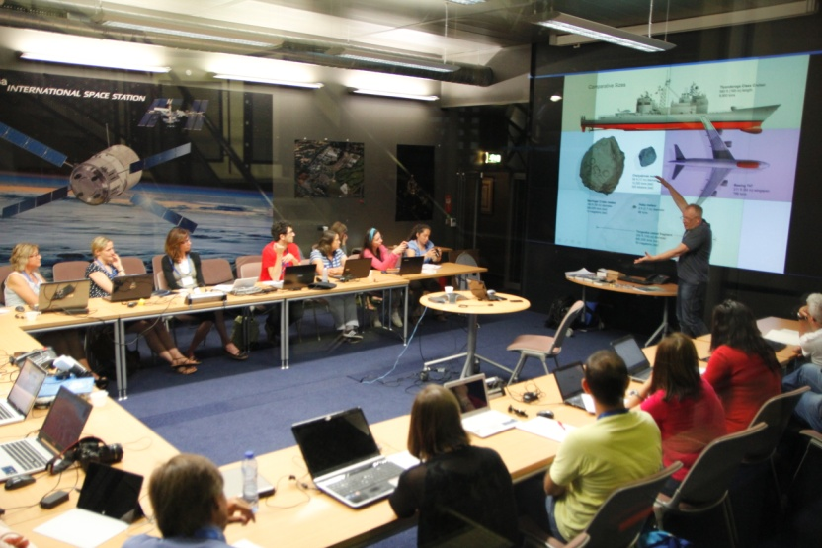
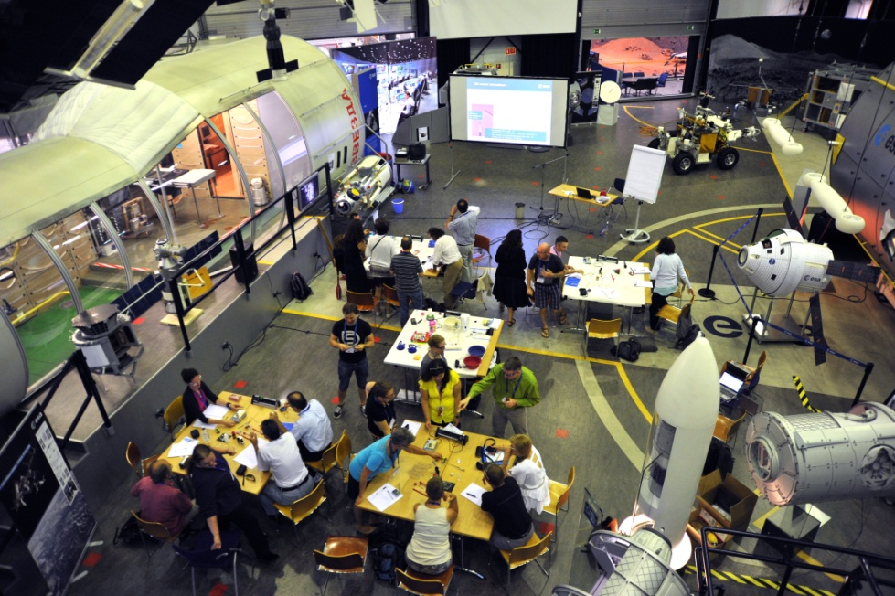
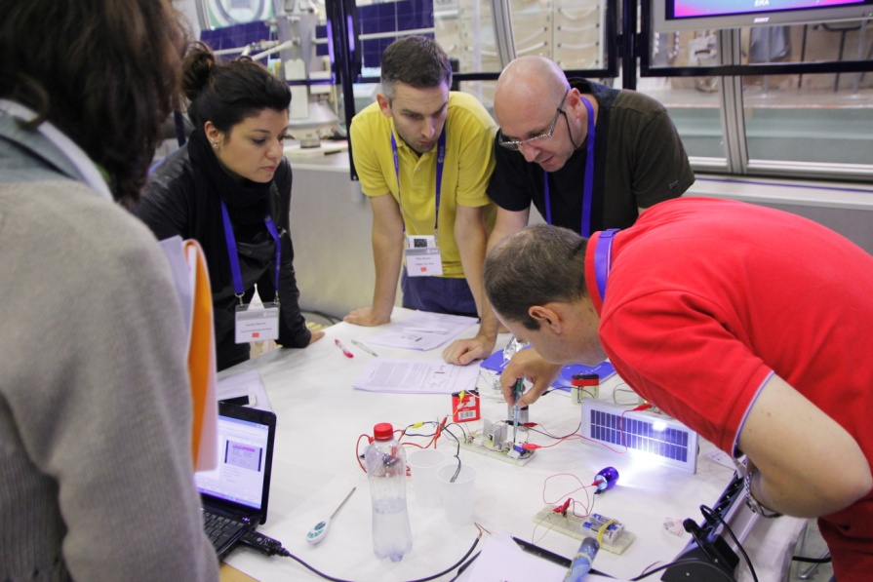
Projects για εκπαιδευτικούς
ESA θερινό σχολείο για εκπαιδευτικούς
2014: 21 έως 25 Ιουλίου 2014
Μάθηση και διαμοιρασμός καινοτόμων και εμπνευσμένων μεθόδων με τη χρήση του διαστήματος για την εμπλοκή των μαθητών με τις φυσικές επιστήμες.
Ανοικτό για εκπαιδευτικούς δευτεροβάθμιας που διδάσκουν STEM σε μαθητές ηλικίας 12-18 ετών από χώρες μέλη της ESA και των συνεργαζόμενων κρατών.
Notes:
ESA summer workshop for teachers
Introduce and explain ESA’s educational resources, such as classroom materials, teaching tools and scientific data to motivated teachers.
Enable participating teachers to make use of these resources in their classrooms.
Encourage participants to disseminate the resources and knowledge gained at the workshop to other teachers.
Establish a network of teachers to support ESA’s education activities and provide feedback on new resources.

Slide 9
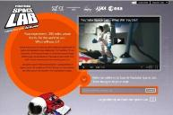
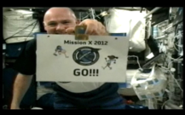

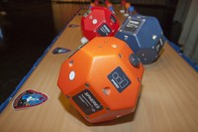

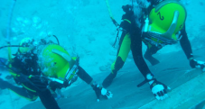
Διεθνείς πρωτοβουλίες:
Συνεργασία με Π/θμια και Δ/θμια εκπαίδευση και στελέχη του ISS
Space Lab: with Google/YouTube, NASA, ESA, JAXA
Global competition launched in Autumn 2011
Winning experiments performed on the ISS, live-streamed to a global audience late 2012.
Mission X: Train Like an Astronaut
Six week programme targeting health and nutrition. Participation of 6000 students and teachers Europe-wide
International Cooperation: 10300 children worldwide participating in 2012
Aimed at primary school students (8-12 years old) - focusing on healthy eating and exercise
SPHERES: ZeroRobotics Competition with NASA and MIT
Secondary school students code 3D algorithms which operate SPHERES (Synchronised Position Hold Engage Reorient Experimental Satellites), free floating satellites on the ISS
NEEMO: NASA Extreme Environment Mission Ops
ESA astronaut participating in this exploration preparatory
activity performing educational experiments
Notes:
SpaceLab:
Since the start of Space Lab in October 2011, over 2000 proposals from 80 nations have been submitted via YouTube.
Space Lab site on Youtube has more than 50 million video views.
The two global winners, selected by an expert panel, will see their experiments sent into orbit and performed on the Space Station.
ESA astronauts joined managers of Google and YouTube from the European Astronaut Centre in Cologne, to present highlights of the Space Lab competition on 30 November.
The YouTube community alongside a prestigious panel of judges was invited to judge these finalists.
The European finalists won a visit to the training facilities of ESA's European Astronaut Centre, Cologne, Germany on 16 May 2012
Google/YouTube, NASA, ESA, JAXA, Space Adventures global competition started 11 October 2011. Students aged 14-18 were asked to submit experiment ideas to be performed on ISS.
2000 video submissions have been received.
ESA astronauts joined managers of Google and YouTube from the European Astronaut Centre in Cologne, to present highlights of the Space Lab competition on 30 November.
Judging the top 60 videos commenced on 17th January by experts from ESA, NASA and the general public.
The winning entry will have the experiment executed on the ISS, and the winning team will enjoy visits to NASA and parabolic flights.
ESA will provide prizes for European winners and runner ups such as visits to EAC and possibility of meeting ESA astronauts.
Mission X- Train Like an Astronaut
Teams of primary school students (8-12 years old) learned about principles of healthy eating and exercise, competed for points by finishing training modules, and inspired to learn more about space and the possibilities for their own future. The lessons and activities will be linked to curriculum science and physical education, with a clear focus on health and nutrition.
6 week educational global programme encouraging children to keep fit and eat healthy by performing physical exercises based on astronaut training programmes.
4 different European sites participated in Mission X In-Flight Call with A. Kuipers on the 2nd of February, when André kicked off the programme from the ISS. Countries participating in the IFC included the Netherlands (SpaceExpo, Noordwijk), Italy (Infinito, Torino), Portugal (Ciencia Viva in Lison) and Switzerland (Museum.BL in Basel). Media, national astronauts and sports personalities attended the events.
From 26-28 April the UK Space Agency, together with NASA and ESA will be hosting an international Mission X special event as part of the 50 Years of the UK in Space celebration. More than 100 students from participating schools around the world will be meeting in London to take part in fitness and space related activities, meet astronaut Paolo Nespoli and to mark their achievement.
Background Info
17 Countries, 7 partner countries (countries that do not host teams but participate to the working group).
12 Languages, 10 Space Agencies
European countries participating: Austria, Belgium, Czech Republic, Denmark, France, Sweden, Germany, Italy, Netherlands, Portugal, Spain, Switzerland and the UK.
Non- European countries participating: USA, Puerto Rico, Colombia, Japan, Mozambique
Partner countries: Columbia, Japan, Puerto Rico, US, South Africa
Next year’s challenge
For the next Mission X “Train like an astronaut challenge 2013”, Oliver Botta from the Swiss Space Office and Johan Marcopoulos from the Swedish Space Office have been contacted. We are hoping that these 2 space offices will join the other International teams of Space Agencies and Offices and be the points of contact for this Challenge with primary schools from their respective countries. Currently 11 space agencies/space offices internationally are involved in this project.
SPHERES: ZeroRobotics – pilot for Europe
ESA has partnered up for the first time with MIT and NASA to participate in an international pilot ZeroRobotics programme, an educational competition where secondary school students code complex 3D algorithms which operate SPHERES, the free floating satellites on the ISS.
3 ESA players (9 European teams) competed against each other on January 23rd using the ISS SPHERES. The games were linked live to Erasmus where the participating schools and teams were present to watch the games unfold and receive prizes and awards.
The winning alliance team is German-Italian, composed by one team from Torino and two from Berlin.
NEEMO
NEEMO is a NASA analog mission that sends groups of astronauts, engineers and scientists to live in Aquarius, the world's only undersea research station, for up to three weeks at a time. The Aquarius habitat and its surroundings provide a convincing analog for space exploration.

Slide 10
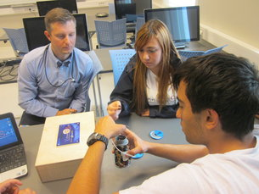
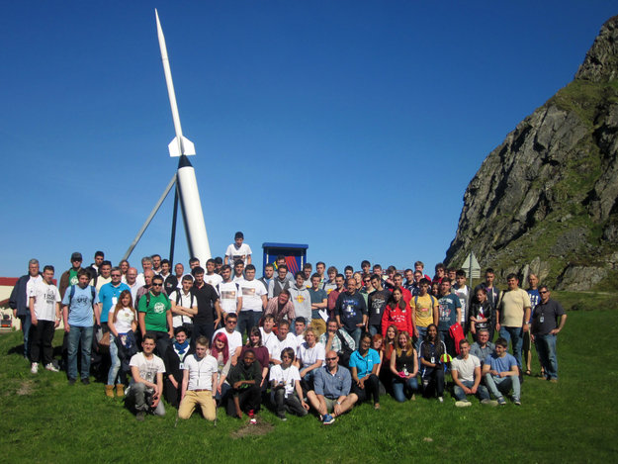
Διαγωνισμός CANSAT
Τι είναι;
Ένας CanSat είναι η προσομοίωση ενός πραγματικού δορυφόρου, κατασκευασμένος εντός του όγκου και του σχήματος ενός κουτιού αναψυκτικού. Η πρόκληση για τους μαθητές είναι να χωρέσουν όλα τα σημαντικά υποσυστήματα που υπάρχουν σε έναν δορυφόρο, όπως η ισχύς και οι επικοινωνίες, μέσα στο μικροσκοπικό κουτάκι. Περισσότερες πληροφορίες: : www.cansat.eu/
Νικητές CANSAT 2013
Στην κατηγορία Προχωρημένοι: Το δεύτερο βραβείο έλαβε η ομάδα Αρίσταρχος από την Ελλάδα (3ο Λυκείου Μυτιλήνης)
Στην κατηγορία Αρχάριοι: Απέσπασε έπαινο η ομάδα ViannoSat από το Λύκειο Βιάννου από την Κρήτη ως η μικρότερη ομάδα που έλαβε ποτέ μέρος στο διαγωνισμό και κατόρθωσε επιτυχημένη εκτόξευση και ολοκλήρωση αποστολής της
CANSAT 2014
Προθεσμία υποβολής μέχρι Κυριακή 7 Δεκεμβρίου

Slide 11
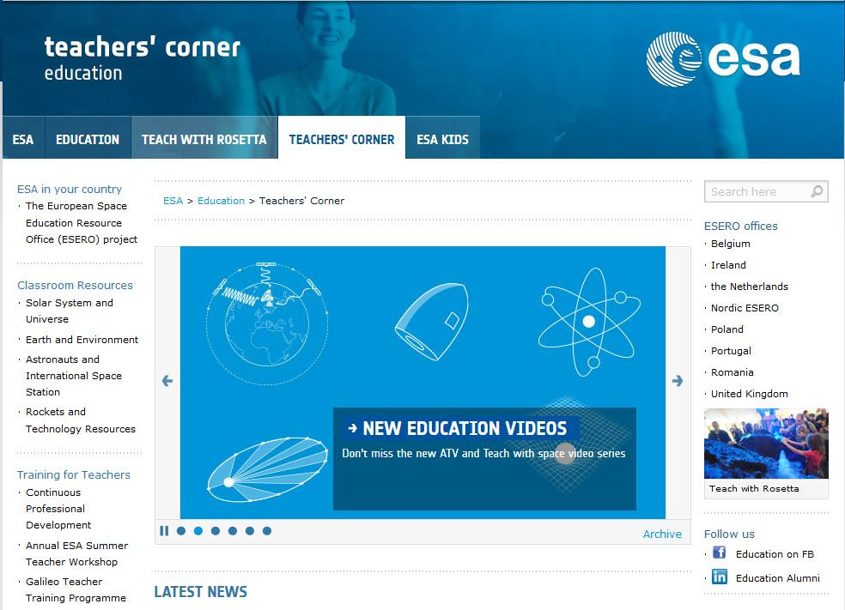
Και Συνεχίζουμε…
http://www.esa.int/Education

